Slide 1
ArduMower

Slide 2
Inhalt
ArduMower Blockdiagramm & Schaltbild
Module:
Arduino, ESP01, SD Card, IMU, Rain, RTC,
Motor Driver, Bumperduino, Raspi
Free Wheel Sensor
Sunray Info
Räder, GPS-Antenna, Messer
Maps

Slide 3
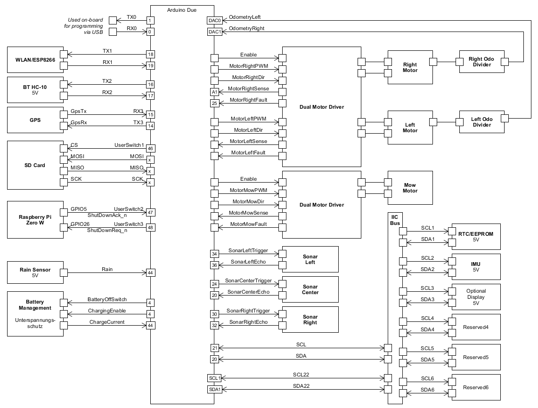
Block Diagram

Slide 4
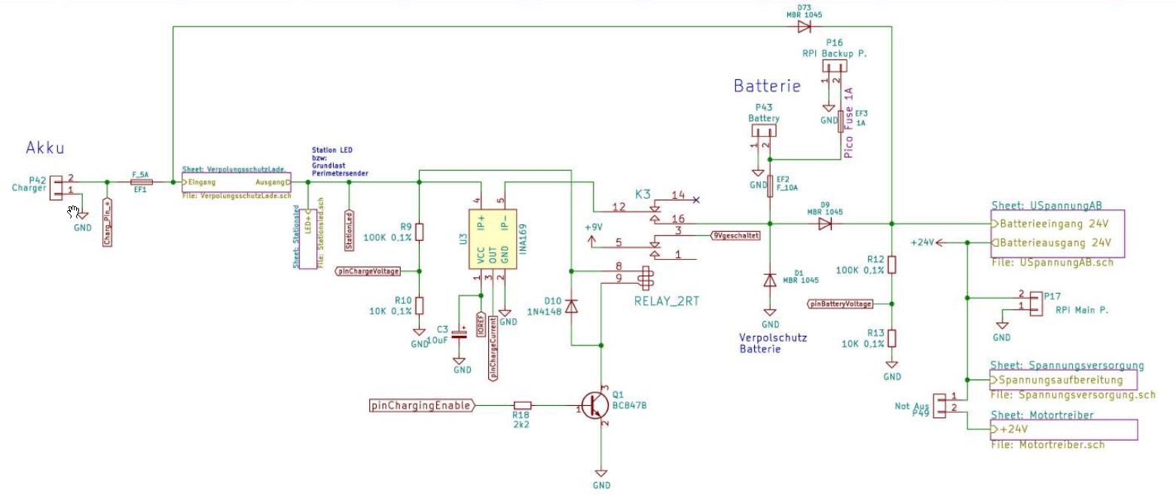
Power Supply
Ladespannung
On/Off Switch

Slide 5
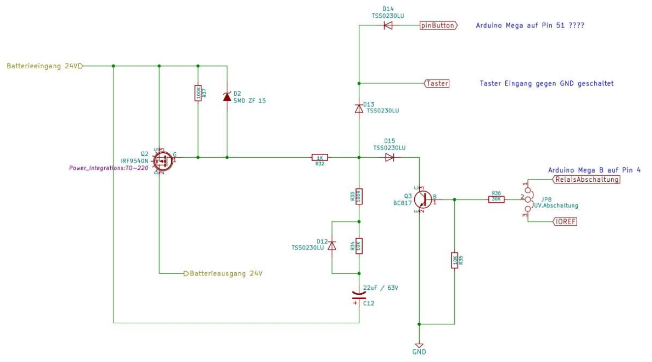
On/Off Switch
Ladespannung
220K

Slide 6
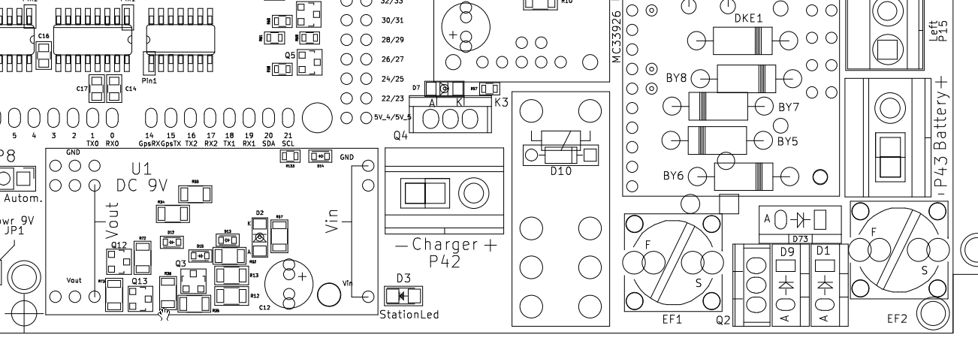
Einschalten über Ladegerät
220K

Slide 7
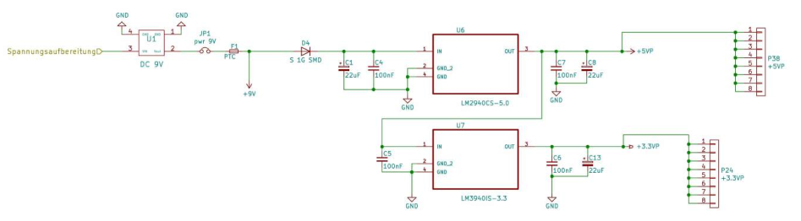
Spannungsaufbereitung

Slide 8
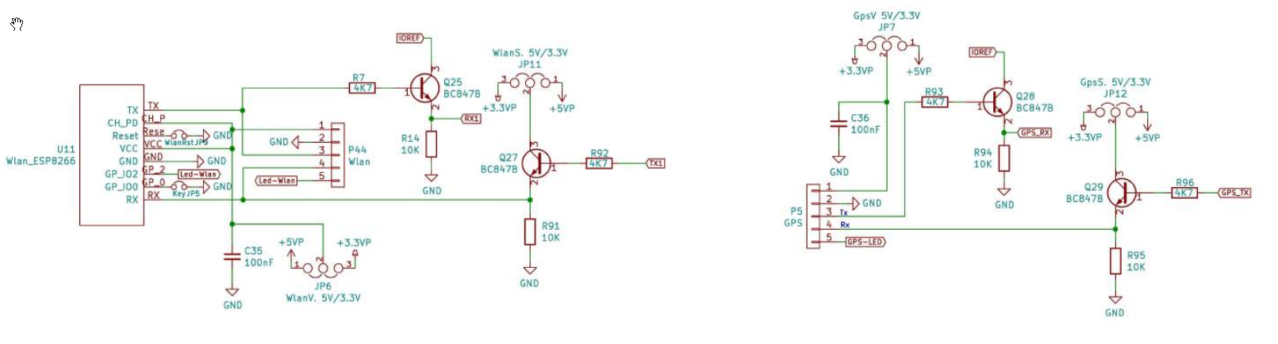
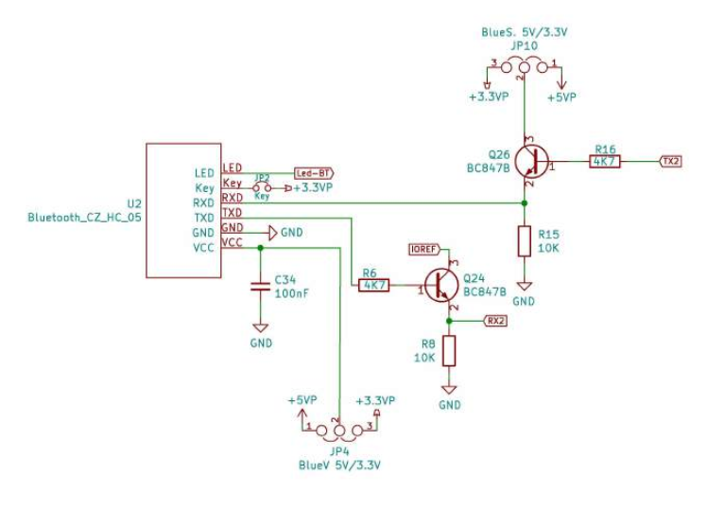
WLAN / GPS / Bluetooth

Slide 9
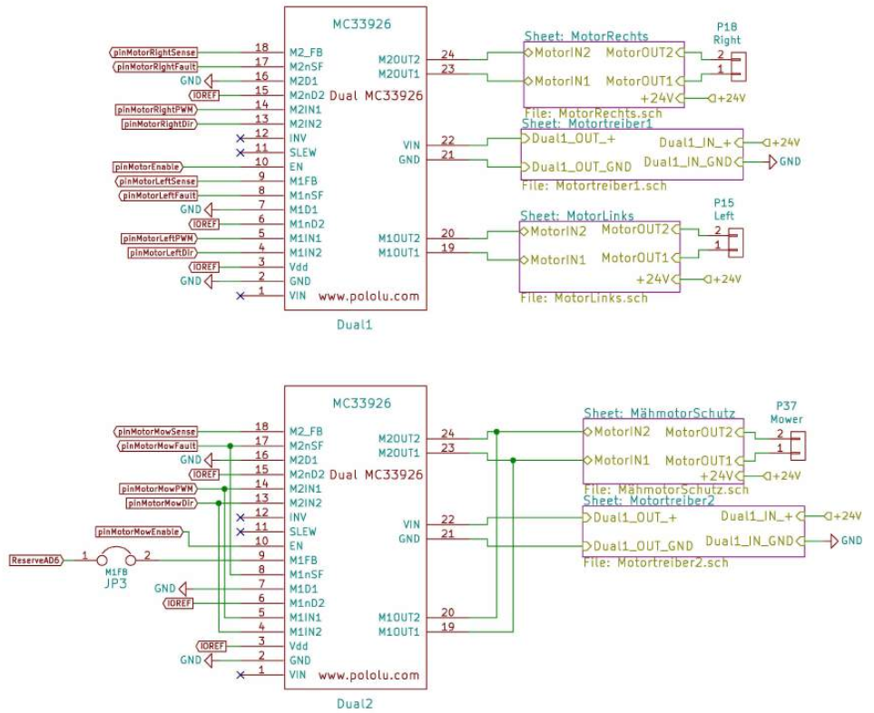
Motor Drivers

Slide 10
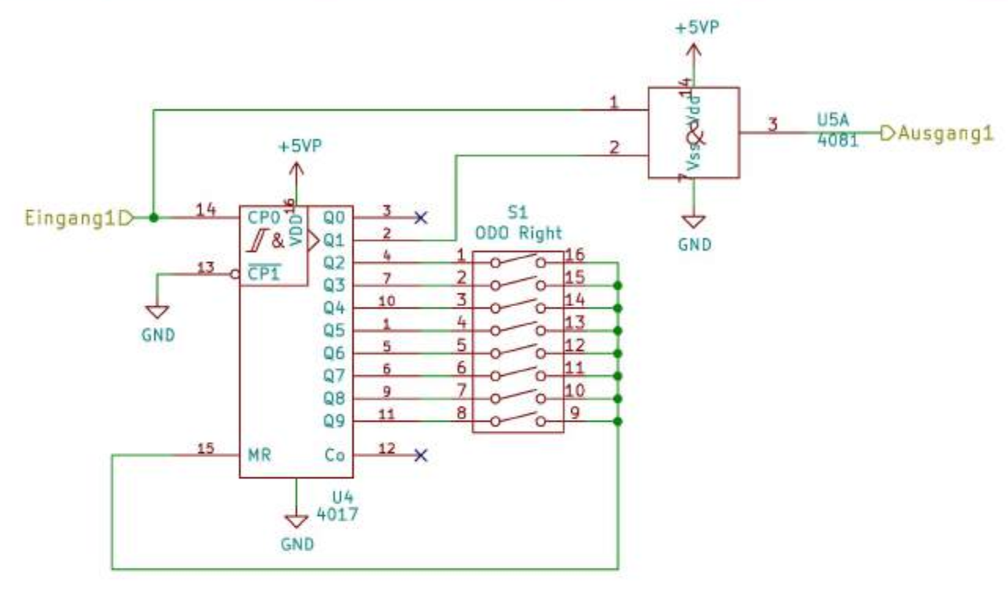
ODO Divider (2x)

Slide 11
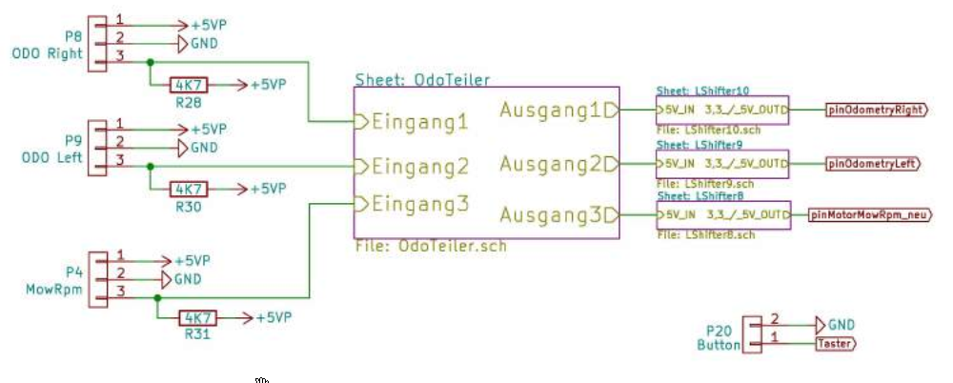
ODO Divider 2/2

Slide 12
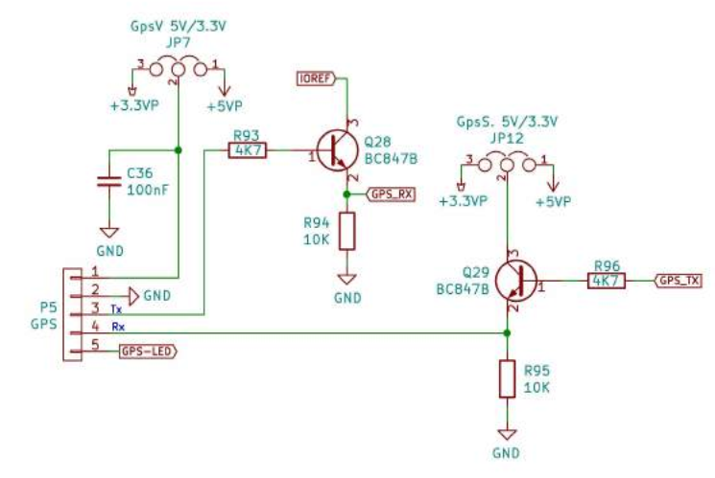
GPS

Slide 13
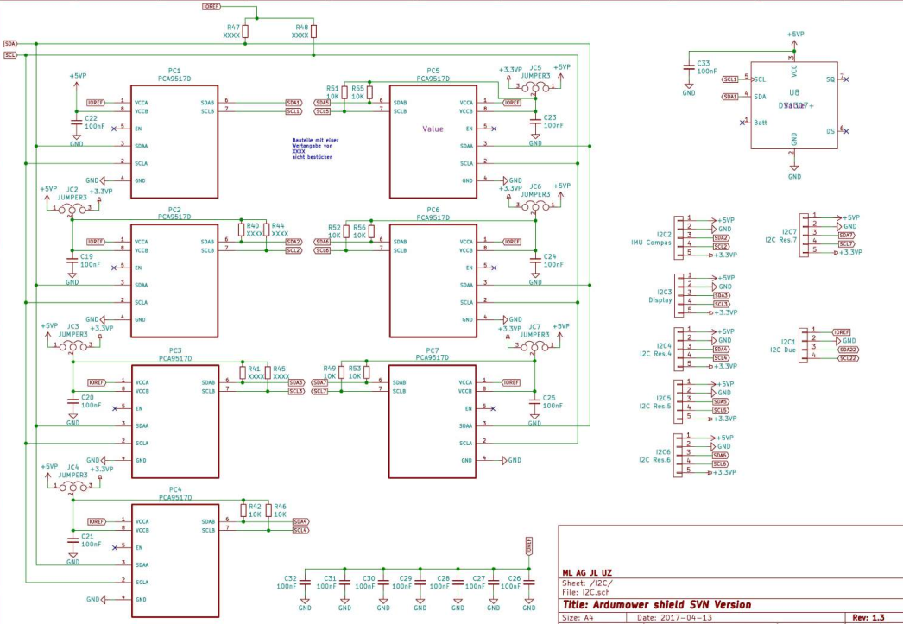
IIC Bus
RTC

Slide 14
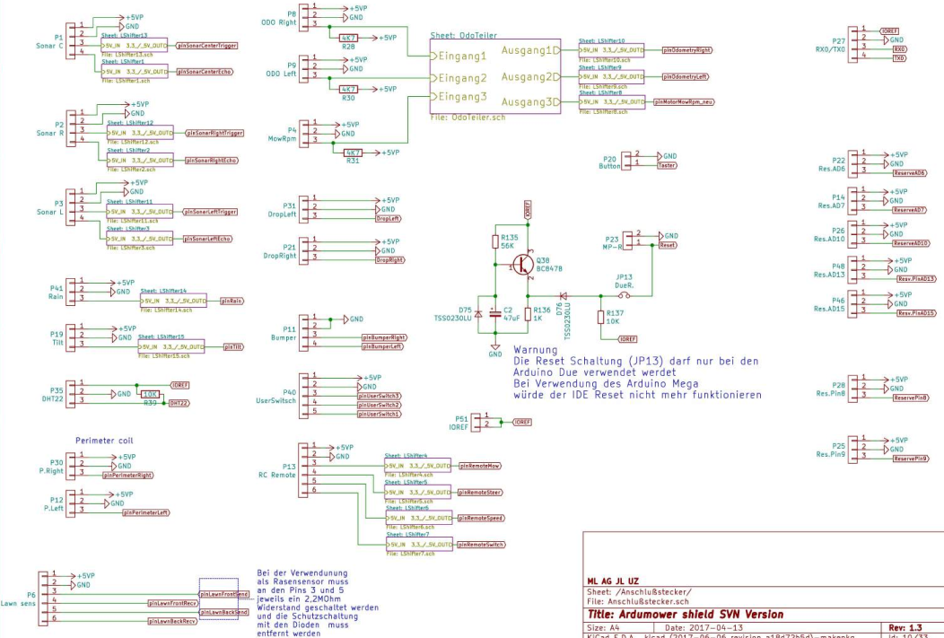
Steckerbelegung

Slide 15
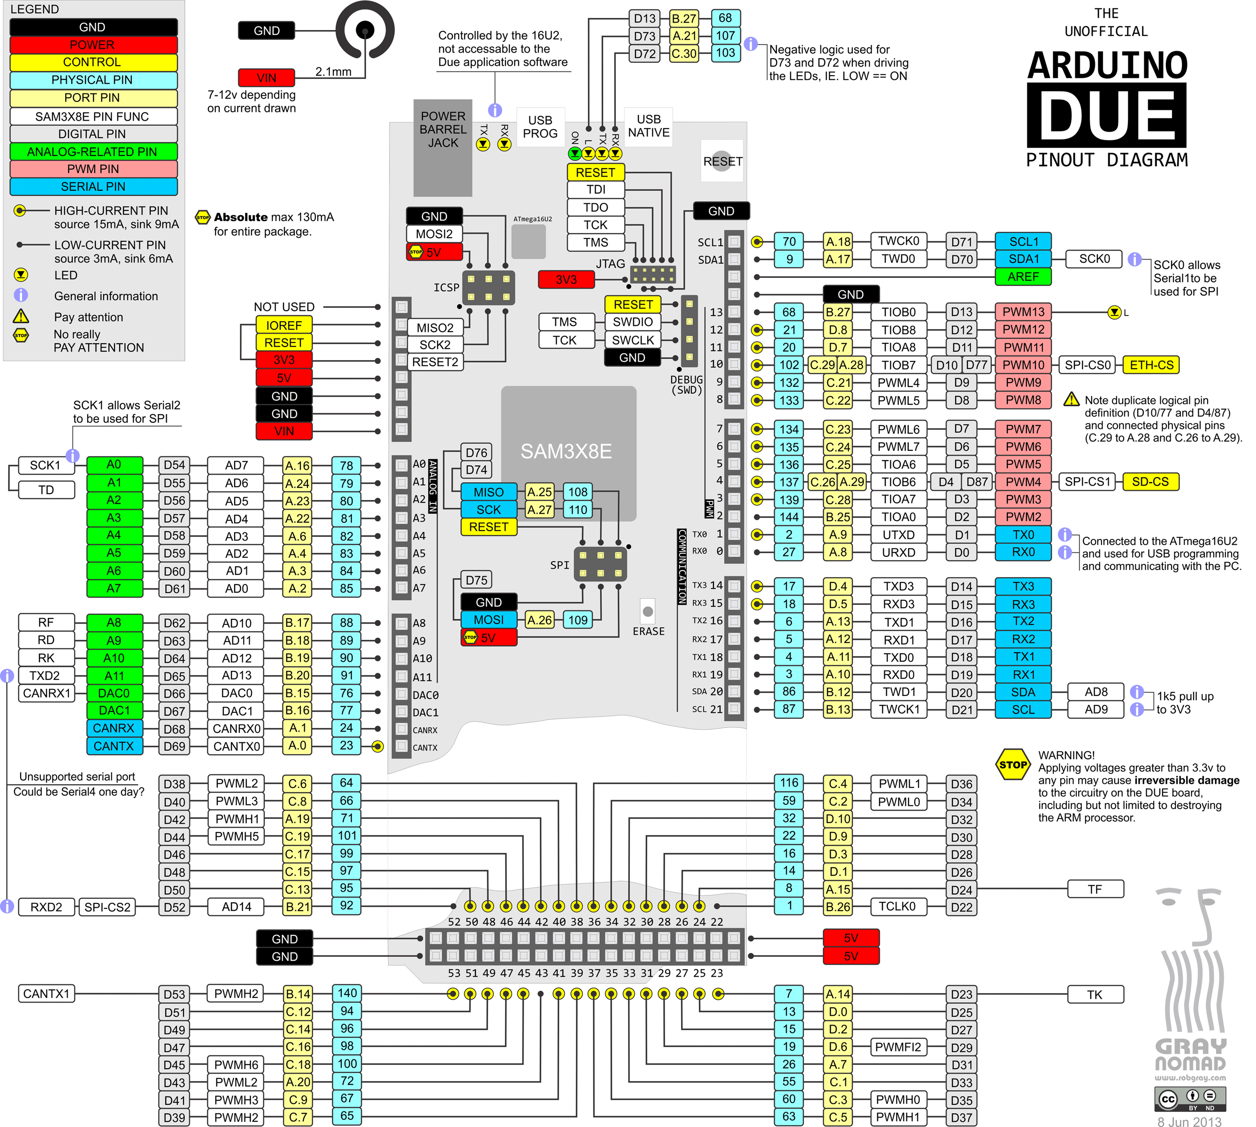

Slide 16
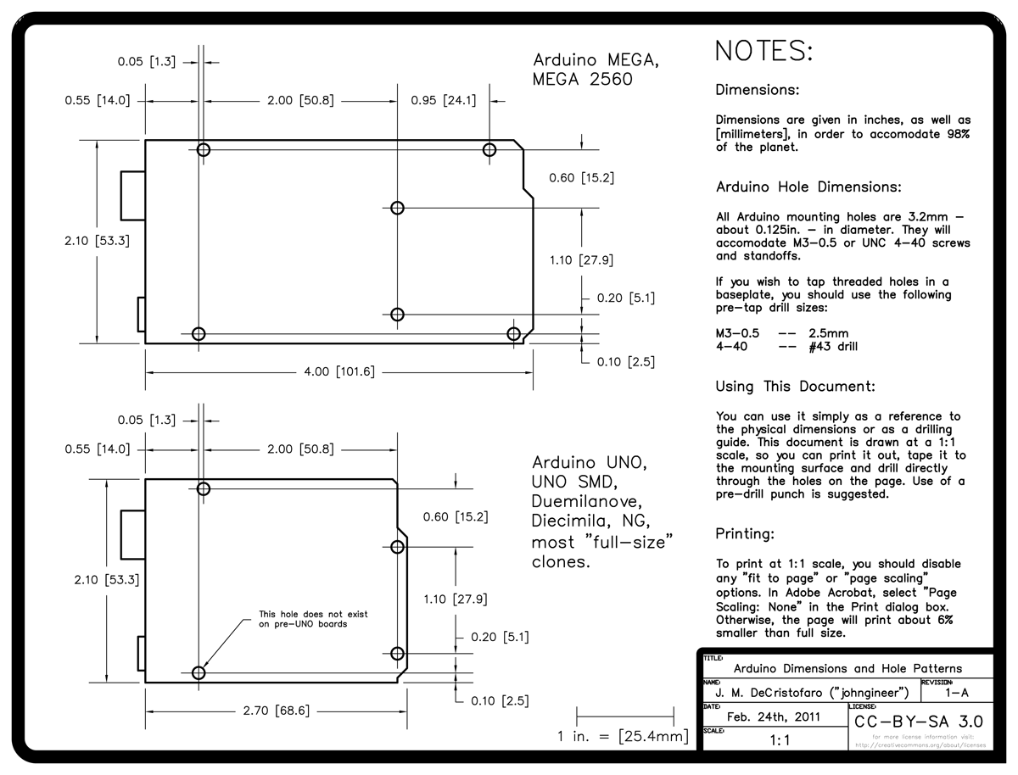
Arduino Abmessungen

Slide 17
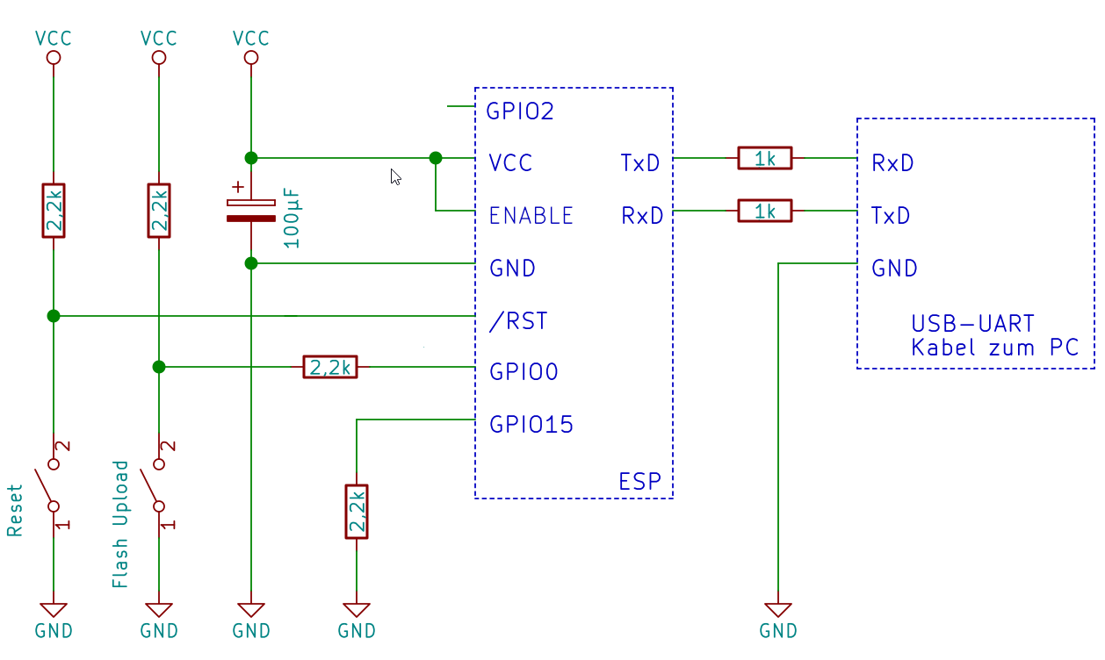
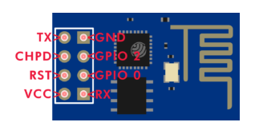
ESP01 Programming
Vcc = 3.3V
Note: GPIO0 outputs 26MHz clock signal after reset!
LINKS:
http://stefanfrings.de/esp8266/
https://www.reddit.com/r/esp8266/comments/9s7tkt/is_my_esp826601_broken_code_doesnt_run_gibberish/
https://hackaday.com/2017/10/01/trouble-flashing-your-esp8266-meet-dio-and-qio/

Slide 18
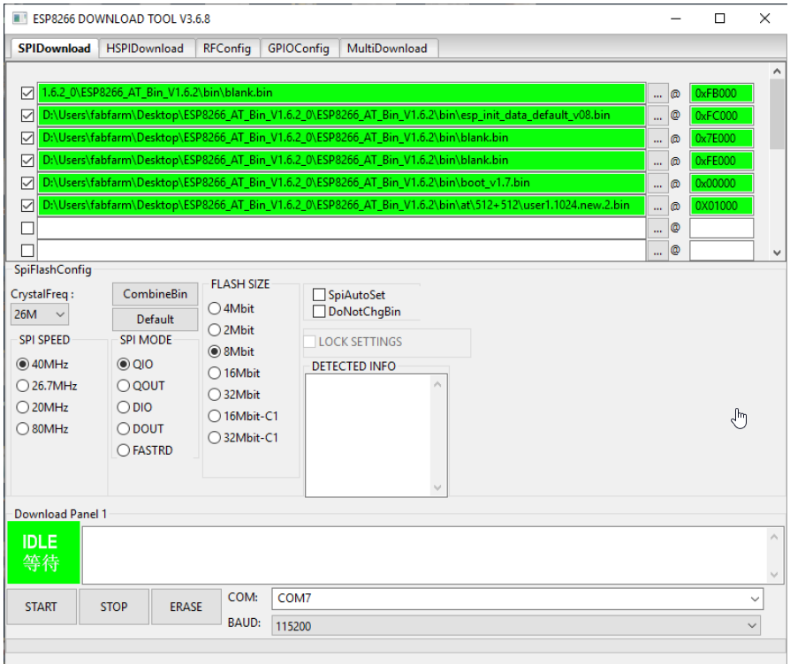
ESP01 Flash Program Settings

Slide 19
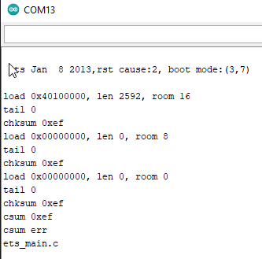
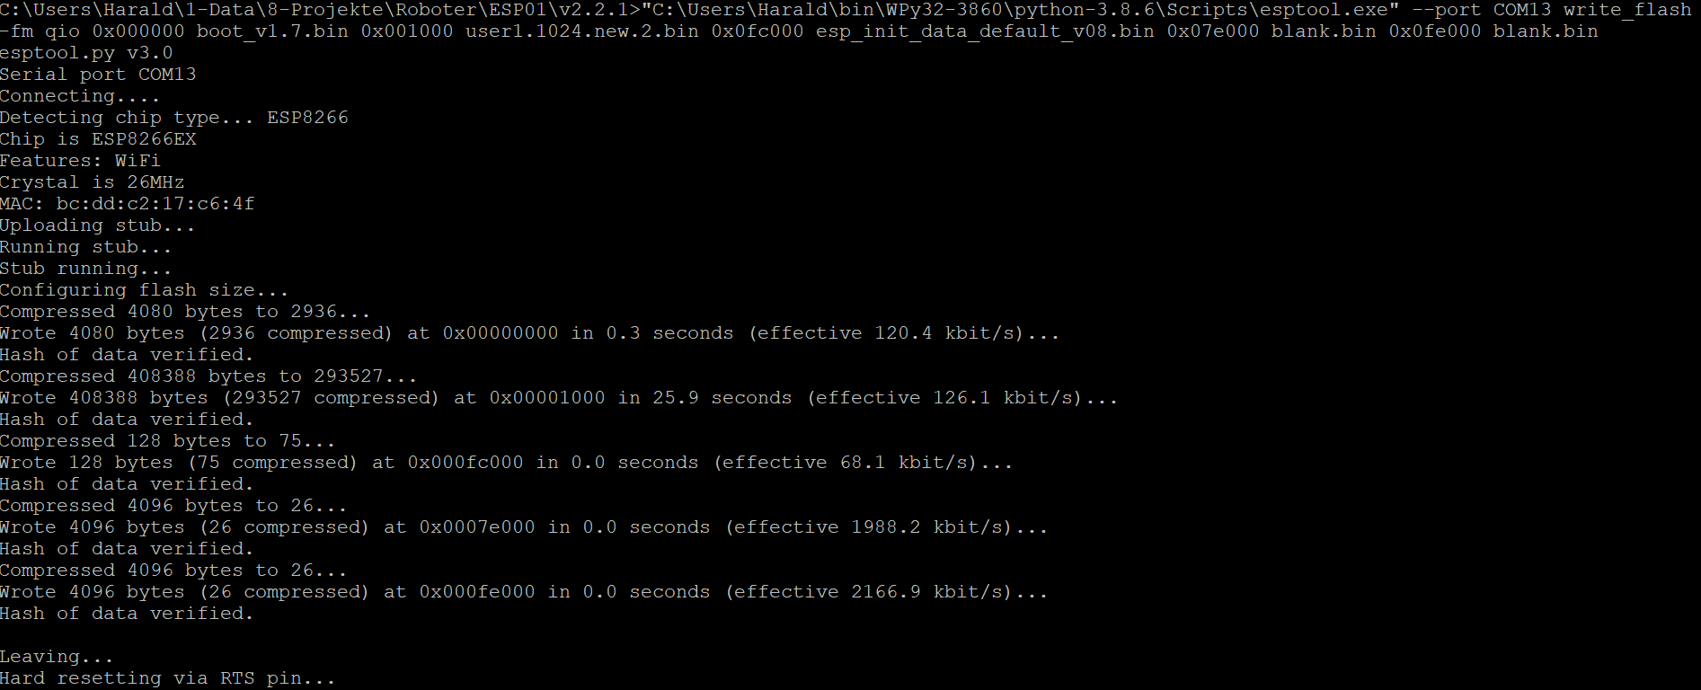
ESP8266 Problem

Slide 20
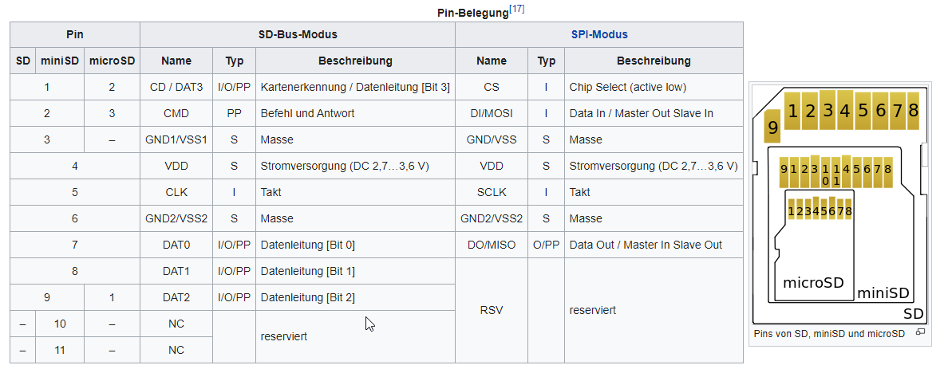
SD Card

Slide 21
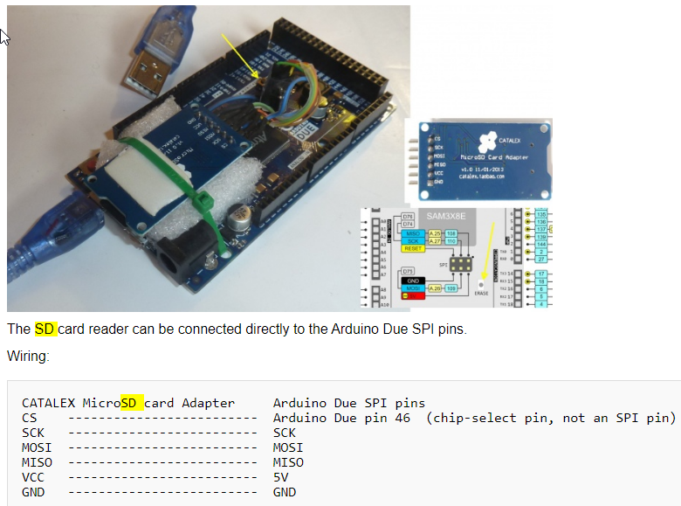
SD Card

Slide 22
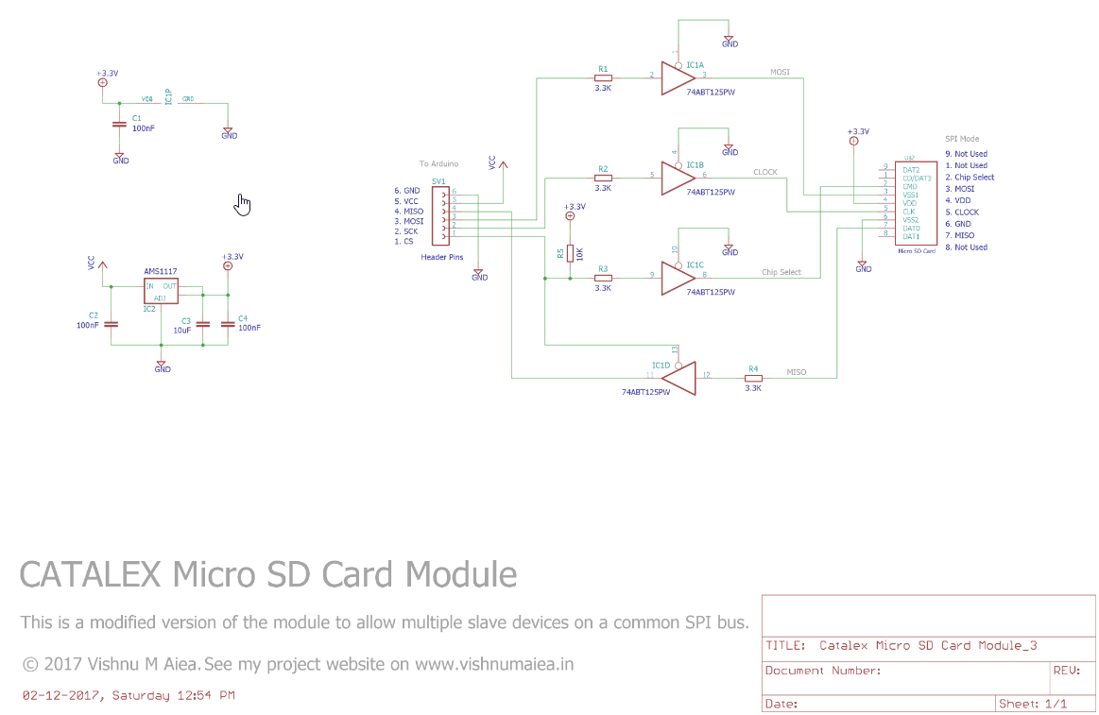
SD Card Reader

Slide 23
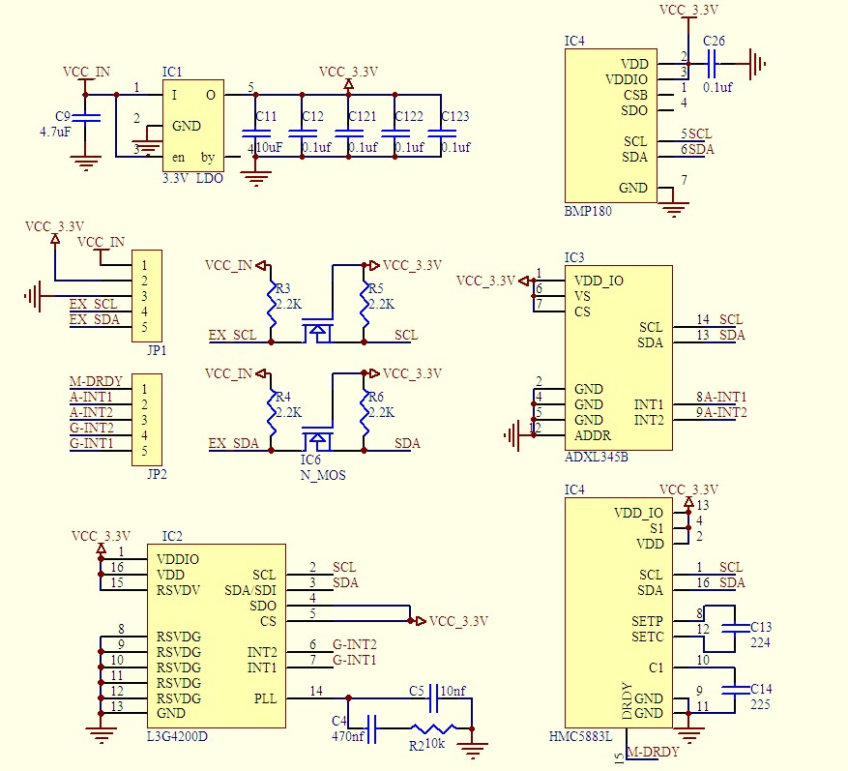
IMU Schaltbild GY-801 (GY-801 wird nicht von Sunray unterstützt)
BMP180 (Barometric
Pressure/Temperature)
ADXL345
(Accelerometer)
MMC5883MC
(Magnetometer)
L3G4200D (Gyroscope)

Slide 24
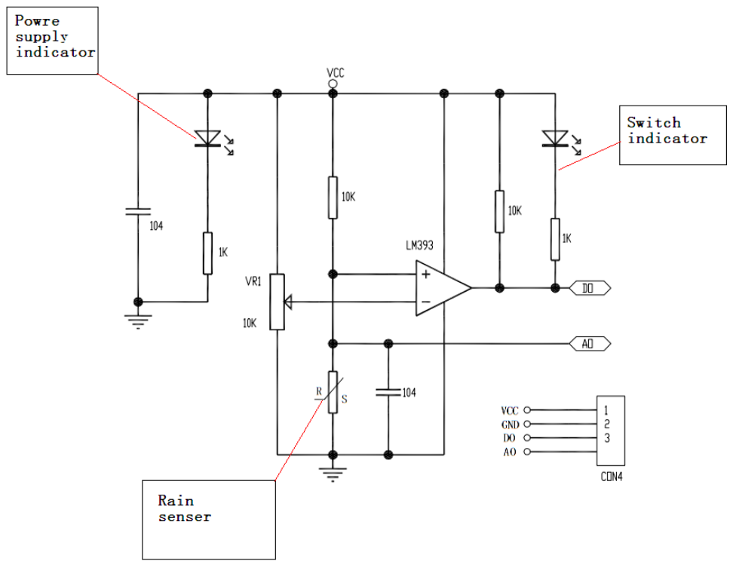
Rain Sensor Module

Slide 25
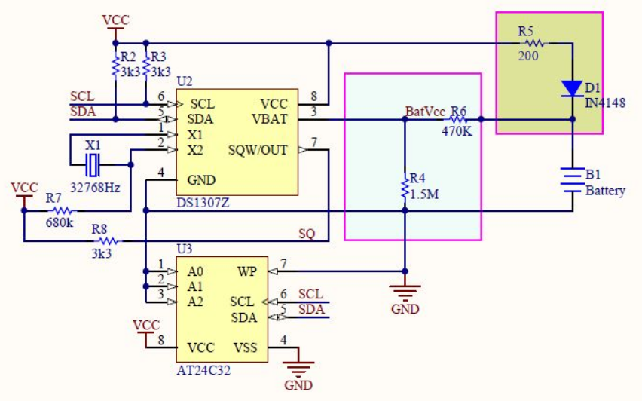
RTC

Slide 26
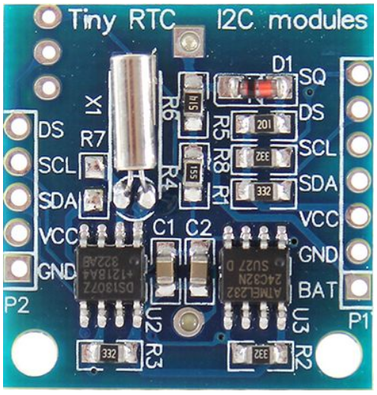
RTC

Slide 27
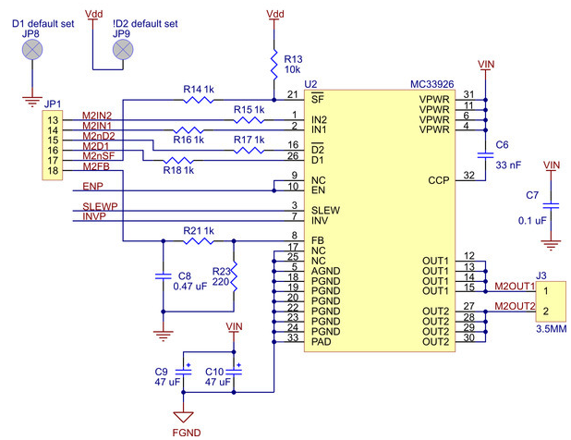
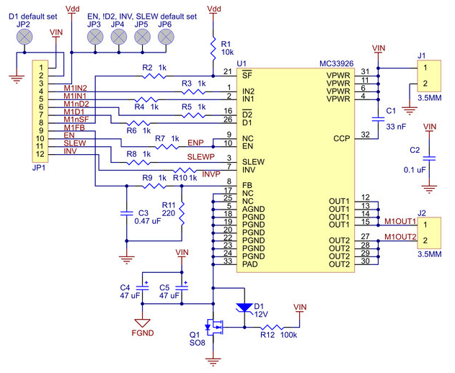
Pololu Dual MC33926 Motor Driver

Slide 28
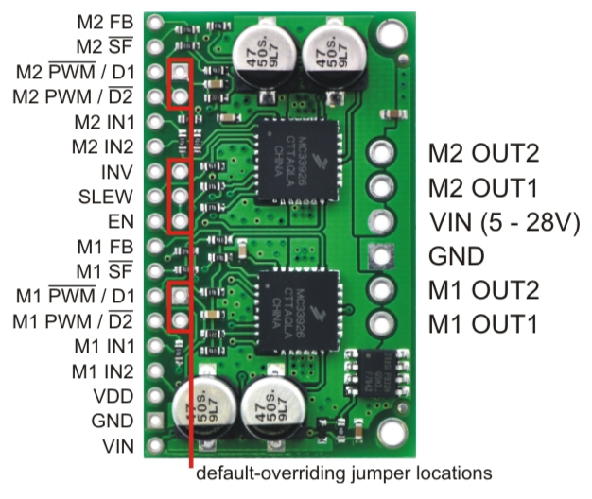
Pololu Dual MC33926 Motor Driver

Slide 29
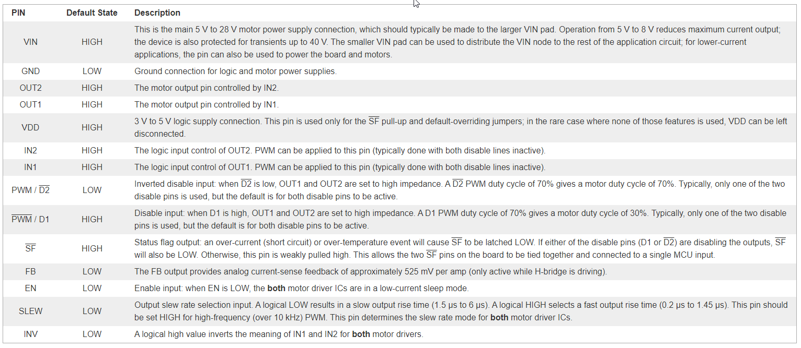
Pololu Dual MC33926 Motor Driver

Slide 30
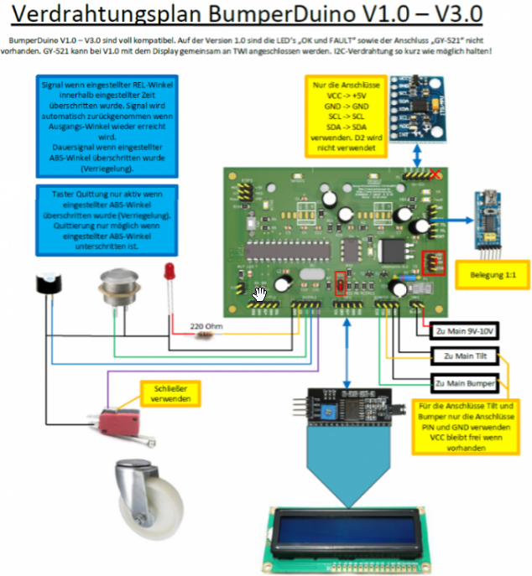
LINK

Slide 31
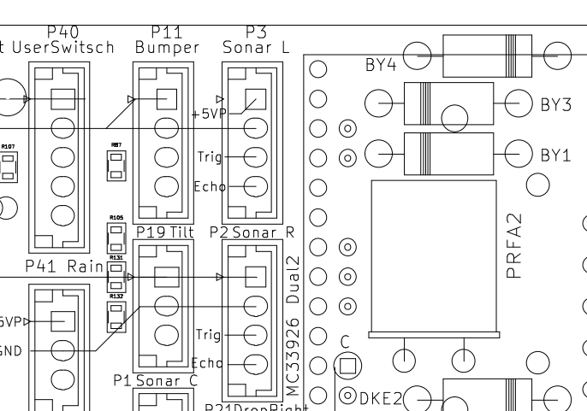
Raspi Shutdown Logic
Raspi Zero
GPIO5
GPIO26
3.3V

Slide 32
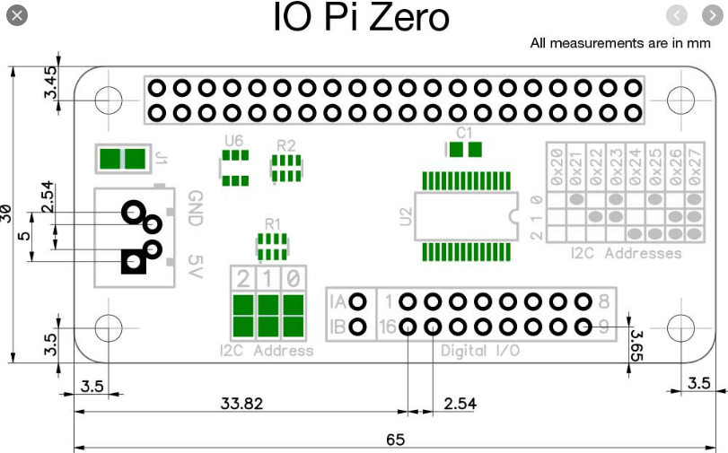
Raspi Zero

Slide 33
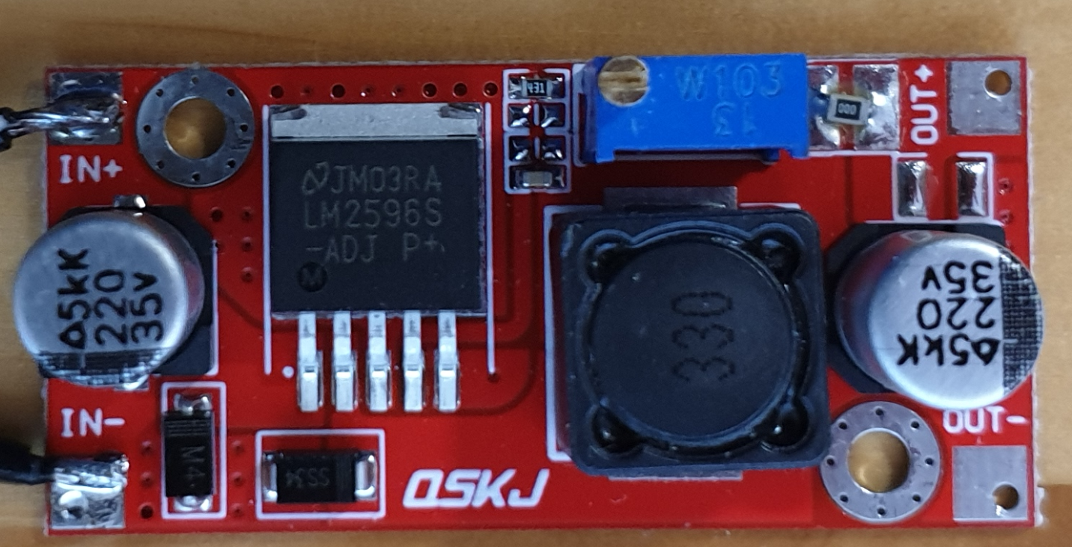
DC/DC-Wandler 24V → 5.2V for Raspi Zero W
Hi=7,79, Bi=15,77 Ha=10,72, Ba=22,86

Slide 34
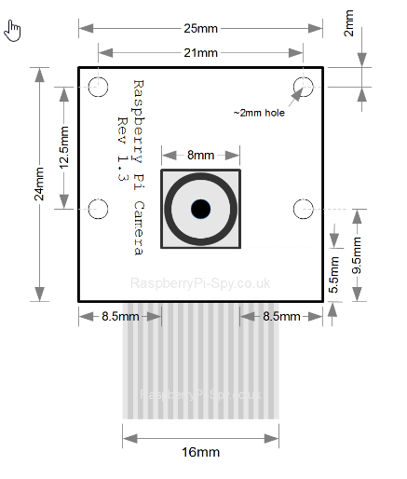
Abmessungen Kamera

Slide 35
Raspi
Video Stream starten:
sudo motion
Video stream URL:
http://192.168.178.68:8081/ oder
http://ardumowerpi:8081/
Logging console:
screen -L /dev/ttyACM0 115200
Abbruch mit: Ctrl-A Ctrl-D
Continue: screen –r
Enter commands:
direct entering of commands does not work as screen sends character by character immediately
Enter command mode with: Ctrl-A ‘:‘
stuff mycommand\n

Slide 36
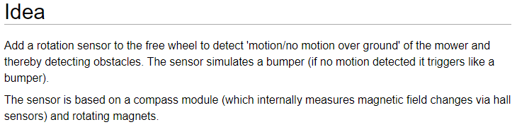
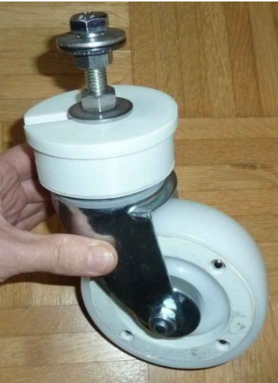
Free Wheel Sensor
Links:
Ardumower Wiki
Ardumower Forum

Slide 37
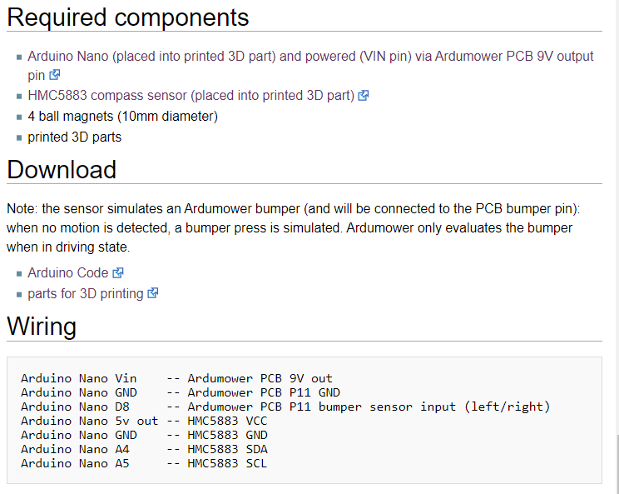
Free Wheel Sensor

Slide 38
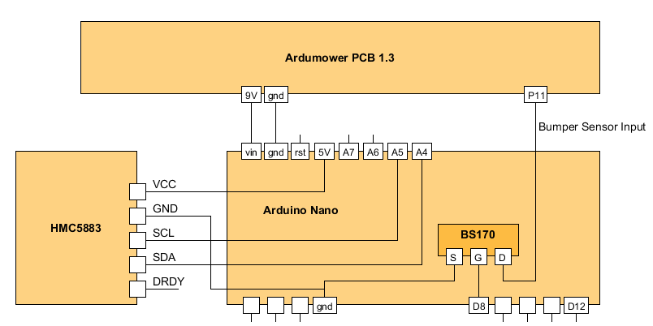
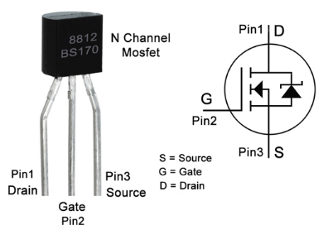
Free Wheel Sensor Schematic

Slide 39
Moonlight Firmware
Moonlight ist der Name meiner modifizerten Sunray firmware
Moonlight Features:
verbessertes Ausgabeformat für Logging
kann Kommandos über UDP verarbeiten
enthält einen Simulationsmodus der mit einem Arduino Due + SD Card + ESP8266 arbeitet
unterstützt zusätzliche Kommandos
unterstützt RTC (Logging Timestamp & SD Card File Date)

Slide 40
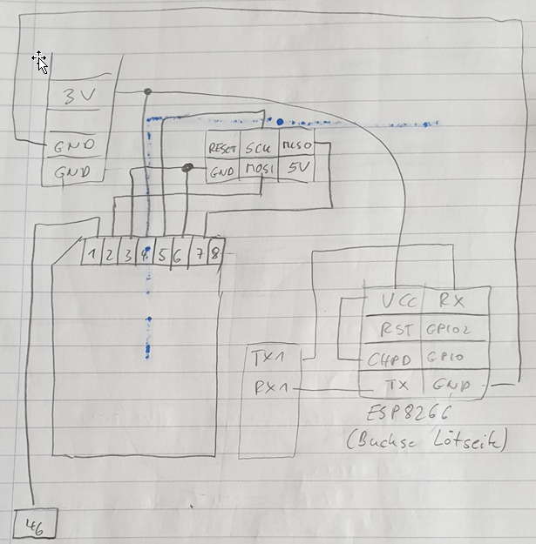

Moonlight Hardware
SD Card
Holder
R2+R3 entfernen!
Arduino
Due Pins
SDA 20
SCL 21

Slide 41
Moonlight Command Overview Sunray Commands
GUI | Command⁽¹⁾ | Short Description
 | AT+M, fLinear, fAngular | Set Motor Linear & Angular Speed
i,d, m⁽⁴⁾ | AT+C, bEnableMowMotor, iOperationType⁽²⁾, fSpeed, iFixTimeout, bFinishAndRestart, fMowingPointPercent, bSkipNextMowingPoint, bEnableSonar | Mower Control
 | AT+W, iIndex, fX, fY | Set Waypoint
 | AT+N, iWayPerimeter, iWayExclusion, iWayDock, iWayMow, iWayFree | Set Waypoints Count
 | AT+X, 0[, iExclusionLength0[, 1, iExclusionLength1[, …]]] | ExclusionCounts
 | AT+P, bAbsolutePosSource, fLongitude, fLatitude | Set Position
 | AT+S | Print Summary
v | AT+V | Print Version Number
s | AT+T | Print Statistics
 | AT+L | Clear Statistics
 | AT+E | Motor Test
 | AT+O | Trigger Obstacle
 | AT+F | Sensor Test
 | AT+G | Toggle GPS.Solution⁽³⁾
 | AT+K | Kidnapping Test
 | AT+Z | Stress Test
 | AT+Y | Trigger Watchdog Test
Notes:
(1) Parameter naming convention: fName=float, iName=int, bName=bool (0 or 1)
(2) OperationType = OP_IDLE, OP_MOW, OP_CHARGE, OP_ERROR, OP_DOCK
(3) GPS.Solution = SOL_INVALID, SOL_FLOAT, SOL_FIXED
(4) “GNSS Reboot“ toggles “BT Logging“ in Sunray App
(5) i=Idle, d=start docking, m=start mowing

Slide 42
Moonlight Command Overview Moonlight Extensions
GUI | Command⁽¹⁾ | Short Description
 | AT+U,CurrentMapIndex | Start Upload Map (informs Moonlight about CurrentMapIndex and initializes map file)
 | AT+D[,[yy]yy,mo,dd,hh,mi,ss,w] | Get/set RTC date and time (w=weekday 0-6; 0=Sunday)
b | AT+Y2 | Toggle Bluetooth Logging⁽⁴⁾
o | AT+Y3 | Switch Off Robot
 | AT+Y4 | Trigger Raspi Shutdown
 | AT+Y5 | GNSS Reboot⁽⁴⁾
 | AT+YS | Toggle SMOOTH_CURVES
p | AT+YP | Toggle UseGPSfloatForPosEstimation
 | AT+YD | Toggle UseGPSfloatForDeltaEstimation
 | AT+YG | Toggle GPS Logging
 | AT+$L[,fileName] | Filesystem: ls fileName (‘*‘ can be used at end of filename as wildcard)
 | AT+$C,fileName | Filesystem: cat fileName
 | AT+$T | Filesystem: ls –R (list all files in folder tree; output to Serial only)
Notes:
(1) Parameter naming convention: fName=float, iName=int, bName=bool (0 or 1)
(2) OperationType = OP_IDLE, OP_MOW, OP_CHARGE, OP_ERROR, OP_DOCK
(3) GPS.Solution = SOL_INVALID, SOL_FLOAT, SOL_FIXED
(4) “GNSS Reboot“ toggles “BT Logging“ in Sunray App

Slide 43
Fix Mode
No fix: either there is not enough data to compute a navigation solution, or the computed solution is outside of the acceptable error criteria
3D: a position solution has been achieved with at least four satellites as compared with a 2D solution with only 3 satellites and altitude/vertical metrics locked to a preset value.
DGNSS: corrections are provided from a source that measures the differences between what pseudorange (signal time-of-flight approximately indicates distance using speed of light through a medium) values for each satellite should be at the precisely surveyed reference station compared to what is reported by its navigation computation. The differences are generally caused by time-varying ionospheric perturbations in the path from satellite to the reference station and the nearby rover. If the rover and reference are too far apart, the separate signal paths may have different perturbations and the correction data are less effective.
Float and fixed: in precise navigation, the receiver tries to lock on to carrier phase (within the 19 cm wavelength) to resolve the exact number of wavelengths and fractions to each satellite. If this exactitude is achieved, the status is "fixed" since phase markers can be locked. if precise wavelengths and fraction are not resolved, ambiguity persists, and the status is "float" since the carrier phase markers are not locked but "floating around" in the mathematical computation. The difference is mm of position accuracy with fixed compared with cm of accuracy with float.

Slide 44
Sunray
Increase SERIAL_BUFFER_SIZE from in to 1024
File: C:\Users\Harald\AppData\Local\Arduino15\packages\arduino\hardware\sam\1.6.12\cores\arduino\RingBuffer.h
Hochladen: C:\Users\Harald\AppData\Local\Arduino15\packages\arduino\tools\bossac\1.6.1-arduino/bossac.exe -i -d --port=COM3 -U false -e -w -b C:\Users\Harald\AppData\Local\Temp\arduino_build_80821/sunray.ino.bin -R

Slide 45
Map Sharing
Jedes Gerät hat eine eigene Geräte ID
Um die Daten eines anderen Geräts zu importiern, muss dessen ID eingegeben werden
Meine Geräte IDs:
Handy: 285626
Asus Laptop: 213740
Surface Pro: 825587

Slide 46
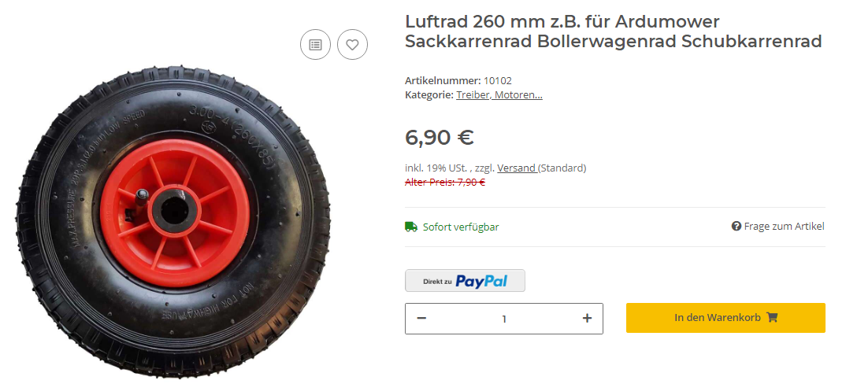
Räder
Standardrad: Durchmesser 25 cm (PE-HD, 8mm)
12“ Reifen-Marktkauf: 30,48 cm
Marotronics Luftrad 260 x 85 mm:

Slide 47
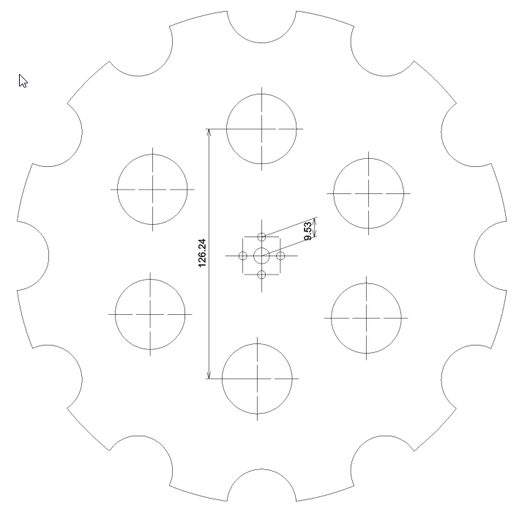
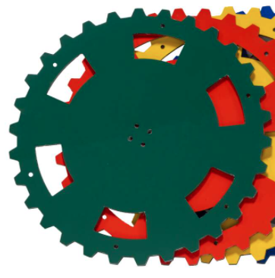
Altes und neues Standardrad
30 Noppen, DM=25cm
Noppenabstand=16cm

Slide 48
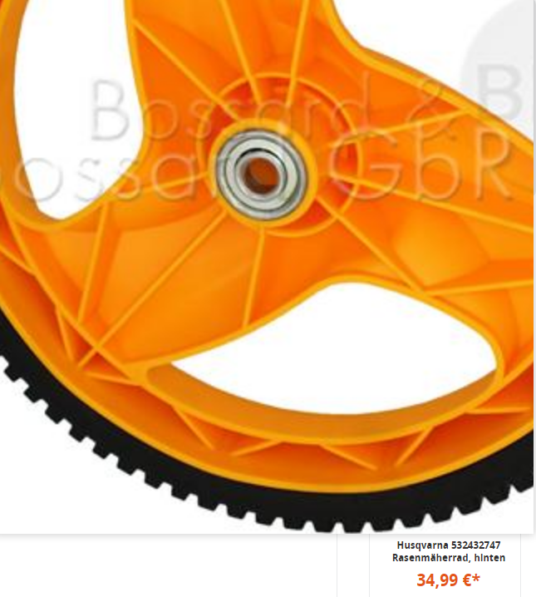
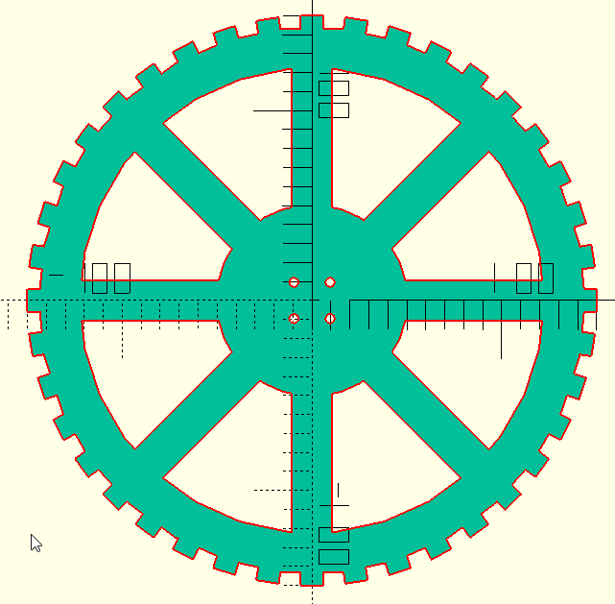
Husquana & mein neues Rad
66 Noppen, DM=30cm
40 Noppen, DM=30cm
Noppenabstand=18cm

Slide 49
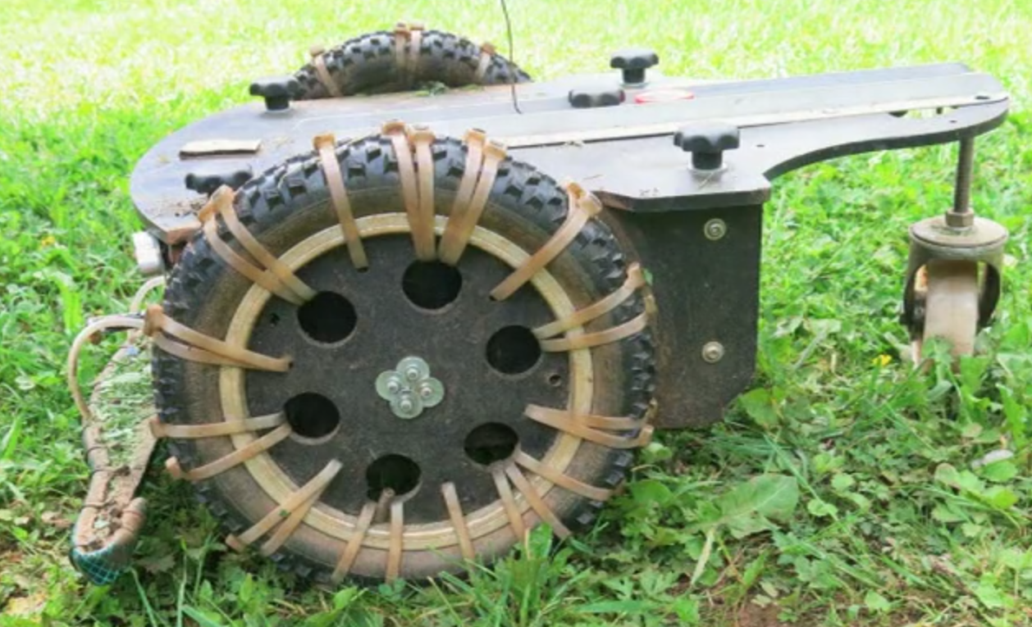
https://vimeo.com/421958805

Slide 50
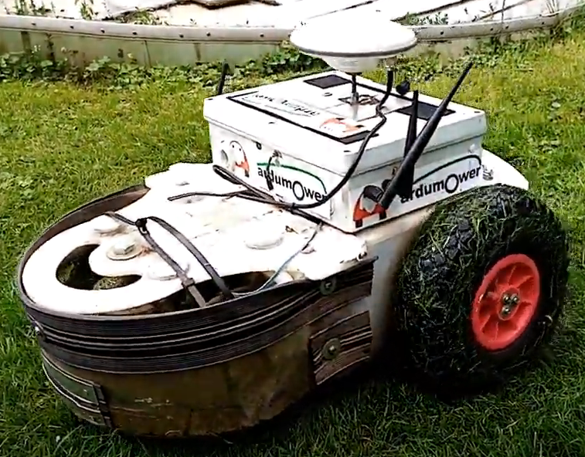
Alternative GPS Antenne

Slide 51
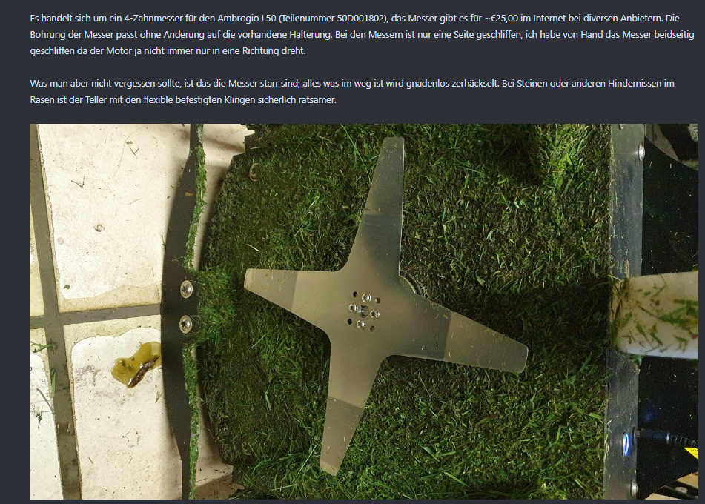
Alternative Messer Ambrogio L50 (Teilenr. 50D001802)

Slide 52

NORD
5,10
52°
3,1 x 4,12
23,45 x 11,62
7,80
27°
3,1/23,45*44,70=5,10m
4,12/23,45*44,70=7,80m
OST
Pattern Angle auf 163° setzen
um in Bahnen parallel zu
unterem Zaun zu mähen!

Slide 53

Google Maps

Slide 54
Mower Ideas
Auto-Power-On, solange Ladegerät angeschlossen ist
Remote-Steuerung über Raspi
Fahren bis zum Zaun, dann rückwärts
Goto mouse point
“Read Map From File“ command
Rename CurrentMapIndex to CurrentMapId
Add CurrentMapIndex to mower state
Add to log: CurrentMapId, #WP, current WP
Use Path Finder & Perimeter With Exclusion Points
Neue Räder (30 cm)
Kamera (360°)
Time-To-First-Fix ausgeben (auch nach GPS Reset)
OTA SW Download
Docking Station für Mäher

